Slide 1
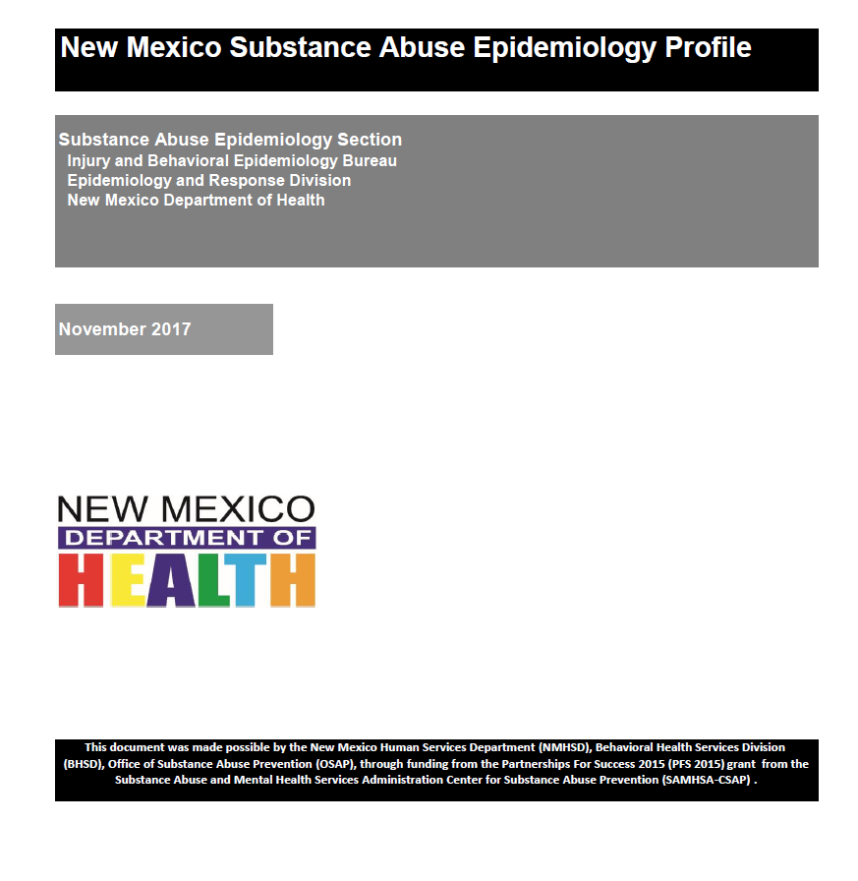
2017 New Mexico Substance Abuse Epidemiology Profile
https://nmhealth.org/data/view/substance/2067/
Ihsan Mahdi, MD MPH
Substance Abuse Epidemiologist
Substance Abuse Epidemiology Section
Epidemiology and Response Division
New Mexico Department of Health

Slide 2
What has been updated?
Death Data (BVRHS): 2016
Emergency Department Visits (DOH-EDD): 2016
Hospital Inpatient Discharges (DOH-HIDD): 2016
Behavioral Risk Factor Surveillance System (BRFSS): 2016
Updated Appendices

Slide 3
Mortality
Indicator | 2015 | 2016
Alcohol-related Deaths | 65.7 | 66.0
Alcohol-related Chronic Disease Deaths | 35.8 | 35.0
Alcohol-related Chronic Liver Disease Deaths | 21.5 | 21.5
Alcohol-related Injury Deaths | 29.9 | 31.0
Alcohol-related Motor Vehicle Crash Deaths | 4.7 | Data not available at print time.
Smoking-related Deaths | 95.6 | 95.2
Drug Overdose Deaths | 24.8 | 24.8
Suicide | 23.5 | 22.2
Rate per 100,000, age-adjusted to the 2000 US standard population Data Source: November 2017 Substance Abuse Epidemiology Profile-Consequences section

Slide 4
Mortality
New Mexico’s total Alcohol-related death rate is 1.9 times the national rate, American Indians have the highest rates (more in men than women), and McKinley and Rio Arriba counties have rates that are 4-5 times the national rate.
Rate per 100,000, age-adjusted to the 2000 US standard population Data Source: November 2017 Substance Abuse Epidemiology Profile-Consequences section
Notes:
Chronic liver disease was the most common cause of chronic alcohol-related deaths while drug overdose was the most common cause of alcohol-related injury deaths.

Slide 5
mortality
Hispanic men had the highest total drug overdose death rate (36.7)
Rio Arriba County had the highest death rate (89.9), with close to half of New Mexico counties showing total drug overdose death rates one and a half times higher than the US rate (16.3 in 2015).
41% of unintentional drug overdose deaths were caused by prescription drugs, while 40% were caused by illicit drugs, and 19% involved both.
New Mexico’s suicide rate in 2016 (22.2) was 1.7 times higher than the national rate in 2016 (13.3). Catron and Hidalgo counties had the highest rates (83.5 and 57.5 respectively). Non-Hispanic Whites had the highest rates overall (27.4).
Rate per 100,000, age-adjusted to the 2000 US standard population Data Source: November 2017 Substance Abuse Epidemiology Profile-Consequences section

Slide 6
Emergency Department & Hospital Discharges
Indicator | 2015* | 2016*
Chronic Liver Disease Hospital Discharge | 57.7 | 83.8
Opioid Overdose-related Emergency Department Visits | 69.1 | 76.6
Rate per 100,000, age-adjusted to the 2000 US standard population Data Source: November 2017 Substance Abuse Epidemiology Profile-Consequences section

Slide 7
Emergency Department & Hospital Discharges
Excessive alcohol use is the most common cause of CLD.
CLD can develop over 20-30 years in some cases, and data on hospitalizations can provide information on CLD risk at an earlier time point in the disease’s development than AR-CLD mortality.
CLD hospitalizations include all hospital stays where the primary diagnosis was determined to be CLD.
CLD hospitalizations measure number of hospital stays rather than individuals diagnosed with CLD (i.e. a person can be hospitalized more than once).
Rate per 100,000, age-adjusted to the 2000 US standard population Data Source: November 2017 Substance Abuse Epidemiology Profile-Consequences section

Slide 8
Emergency Department & Hospital Discharges
The rate of CLD hospitalizations in 2016 (83.8) has increased 41.6% since 2010 (59.2).
McKinley County had the highest rate of CLD hospitalizations (146.0), followed by Cibola (123.8), the state rate was (74.3).
Rate per 100,000, age-adjusted to the 2000 US standard population Data Source: November 2017 Substance Abuse Epidemiology Profile-Consequences section
Notes:
American Indians showed the highest CLD hospitalization rates.

Slide 9
Emergency Department & Hospital Discharges
Mortality is just one, and the most extreme, of the health outcomes associated with drug abuse.
In the U.S., between 2004 and 2009, there was a 98.4% increase in emergency department (ED) visits related to misuse or abuse of prescription drugs, particularly opioids.
In NM, the emergency department dataset (EDD) is collected in accordance with the NM Public Health Act and New Mexico Administrative Code 7.4.3.10
Rate per 100,000, age-adjusted to the 2000 US standard population Data Source: November 2017 Substance Abuse Epidemiology Profile-Consequences section
Notes:
The male rate of opioid-related overdose emergency department visits during 2012-2016 was 28.7% higher than the rate among women. Non-Hispanic Whites showed the highest rates.

Slide 10
Emergency Department & Hospital Discharges
Between 2010 and 2016, the rate of opioid-related overdose emergency department visits increased by almost 60%.
Rio Arriba (207.8), San Juan (135.2), and Taos (130.3) had the highest rates of opioid-related overdose emergency department visits during 2012-2016.
Rate per 100,000, age-adjusted to the 2000 US standard population Data Source: November 2017 Substance Abuse Epidemiology Profile-Consequences section
Notes:
The male rate of opioid-related overdose emergency department visits during 2012-2016 was 28.7% higher than the rate among women. Non-Hispanic Whites showed the highest rates.

Slide 11
BRFSS-mental health
Indicator | 2013-2015 | 2014-2016
Frequent Mental Distress (past 30 days) | 11.9%* | 12.0%*
 | 2015 | 2016
Adult Current Depression (past 2 weeks) | 10.3%** | 9.9%**
*Estimate of percent of people in population group who reported Frequent Mental Distress in past 30 days
**Estimate of percent of people in population group who reported current (past 2-week) depression based on DSM-IV criteria
Data Source: November 2017 Substance Abuse Epidemiology Profile-Mental Health section

Slide 12
BRFSS-mental health
Frequent Mental Distress (FMD) is based on the single question, "How many days during the past 30 days was your mental health not good?" Respondents who report that they experienced 14 or more days when their mental health was "not good" are classified as experiencing FMD.
Current depression is defined using the Diagnostic and Statistical Manual of Mental Disorders, 4th Edition (DSM-IV) criteria, based on respondents’ answers to Patients Health Questionnaire (PHQ-8).
More than half (52%) of FMD respondents were diagnosed with current depression.
Depression was more common among Hispanic females (11.5%), and White females (9.6%) than American Indian females (6.8%)
Data Source: November 2017 Substance Abuse Epidemiology Profile-Mental Health section
Notes:
the prevalence of current depression was highest among the age-group 25-64 years (10.2%), slightly higher among females than males across the age range, and much higher among Black (22.9%) than Hispanic (9.6%) and White adults (9.3%).
The PHQ-8 contains 8 of the 9 criteria for diagnosis of major depression as defined in the fourth edition of the Diagnostic and Statistical Manual of Mental Disorders. These questions ask the respondent to indicate how many days each of the following has occurred in the past 2 weeks: 1) had little interest or pleasure in doing things; 2) felt down, depressed, or hopeless; 3) had trouble falling asleep or staying asleep or sleeping too much; 4) felt tired or had little energy; 5) had a poor appetite or ate too much; 6) felt bad about yourself, or felt that you were a failure or had let yourself or your family down; 7) had trouble concentrating on things, such as reading the newspaper or watching television; 8) moved or spoke so slowly that other people could have noticed, or being so fidgety or restless that you were moving around a lot more than usual. The number of days for each question is converted to points (0-1 day = 0 points; 2-6 days = 1 point; 7-11 days = 2 points; and 12-14 days = 3 points), and the number of points is totaled for the 8 questions to determine a depressive symptoms severity score

Slide 13
BRFSS-mental health
Data Source: November 2017 Substance Abuse Epidemiology Profile-Mental Health section

Slide 14
Brfss- Alcohol and tobacco consumption
Indicator | 2013-2015 | 2014-2016
Adult Binge Drinking* | 13.8%** | 13.9%**
Adult Heavy Drinking♠ | 5.4%** | 5.2%**
Adult Drinking and Driving | 1.1%** | 1.0%**
Adult Smoking | 18.6%** | 17.3%**
*Binge drinking definition: 1998-2005, drinking five or more drinks on an occasion at least once in the past 30 days; 2006-present,
drinking five or more drinks (for men) or four or more drinks (for women) on an occasion at least once in the past 30 days.
** Estimate of percent of people in population group who reported binge drinking at least once in past 30 days
♠Heavy drinking definition: drinking more than 2 drinks/day on average (for men) or more than 1 drink/day (for women)
Data Source: November 2017 Substance Abuse Epidemiology Profile-Consumption section

Slide 15
Brfss-Alcohol consumption
Binge drinking rates decrease with age and are higher among males.
Data Source: November 2017 Substance Abuse Epidemiology Profile-Consumption section

Slide 16
Brfss-alcohol consumption
For the period 2012-2016 heavy drinking prevalence is lower among adults in New Mexico (5.2%) than in the US overall (6.5%), and more reported by men than women.
Data Source: November 2017 Substance Abuse Epidemiology Profile-Consumption section

Slide 17
Brfss-alcohol and tobacco consumption
American Indian males had the highest reported rate of heavy drinking (7.0%) followed by Hispanic males (6.7%). However, among women, Black females had the highest rate (11.7%), followed by White women (6.5%).
Hidalgo county showed the highest reported rates for both binge and heavy drinking (20.8% and 11.7% respectively).
New Mexico men were three times more likely to report drinking and driving than women (1.6% vs. 0.5%).
In 2016, current smoking rates among adults in New Mexico (16.6%) were slightly less than the US overall (17.0%).
Data Source: November 2017 Substance Abuse Epidemiology Profile-Consumption section

Slide 18
National Survey on Drug Use and Health (NSDUH)
Changes to the NSDUH Questionnaire and data collection:
In 2015, a number of changes were made to the NSDUH questionnaire and data collection procedures resulting in the establishment of a new baseline for a number of measures. Therefore, estimates for several measures included in prior reports are not available. For details, see Section A of the "2014-2015 NSDUH: Guide to State Tables and Summary of Small Area Estimation Methodology" at: http://www.samhsa.gov/data/.

Slide 19
the 2012-2014 NSDUH
Measures used:
ALCOHOL
Past Month Alcohol Use
Past Month Binge Alcohol Use
Perceptions of Great Risk of Having Five or More Drinks of an Alcoholic Beverage Once or Twice a Week
ILLICIT DRUGS
Past Month Illicit Drug Use
Past Year Marijuana Use
Past Month Marijuana Use
Past Month Use of Illicit Drugs Other Than Marijuana3
Past Year Cocaine Use
Past Year Nonmedical Pain Reliever Use
Perception of Great Risk of Smoking Marijuana Once a Month
Average Annual Marijuana Initiation Rate
TOBACCO
Past Month Tobacco Product Use5
Past Month Cigarette Use
Perceptions of Great Risk from Smoking One or More Packs of Cigarettes per Day
*Data reported by age group, and NM&US health region, as percentages and 95% confidence intervals.

Slide 20
the 2014-2015 NSDUH
Measures used*:
ILLICIT DRUGS
Past Year Marijuana Use
Past Month Marijuana Use
Past Year Cocaine Use
Past Year Heroin Use
First Use of Marijuana
ALCOHOL
Past Month Alcohol Use
Past Month Alcohol Use (12-20 Years)
PAST YEAR ALCOHOL USE DISORDER
Alcohol Dependence
Alcohol Use Disorder
TOBACCO PRODUCTS
Past Month Tobacco Product Use
Past Month Cigarette Use
PAST YEAR MENTAL HEALTH ISSUES
Major Depressive Episode
Serious Mental Illness
Any Mental Illness
Had Serious Thoughts of Suicide
*Data reported by age group, and US health region, as estimated numbers (in thousands), and percentages.

Slide 21
THANK YOU!
Questions?
Ihsan.mahdi@state.nm.us
(505) 827-0887

